Slide 1
TIME SERIES ANALYSIS

Slide 2
TODAY’S LEARNING OBJECTIVES
TIME SERIES ANALYSIS
Understand what makes time series data unique compared to other analyses
Prepare and format data for time series analysis
Perform exploratory time series analysis with pandas including moving averages and autocorrelation

Slide 3
COURSE
PRE-WORK

Slide 4
PRE-WORK REVIEW
Knowledge of data analysis and formatting with pandas
Understand the correlation measure of association with python

Slide 5
OPENING
TIME SERIES ANALYSIS

Slide 6
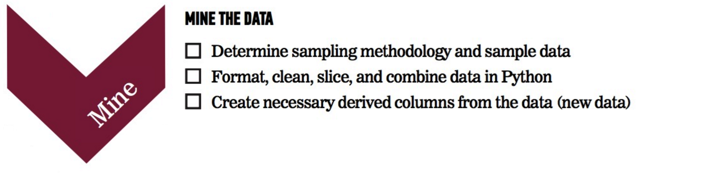


WHERE ARE WE IN THE DATA SCIENCE WORKFLOW?
Data has been acquired, but we’ll need to parse, mine, and refine it.
We’ll also use plots to represent the results.

Slide 7
TIME SERIES ANALYSIS
Today, we’ll discuss analyzing data that is changing over time. In most of our previous examples, we didn’t care about when the data points were collected.
Instead, we made assumptions that the data was not changing over time or that our analysis would not take that into account.
This class will focus on statistics around data that is changing over time and how to measure that change.

Slide 8
INTRODUCTION
WHAT IS TIME SERIES DATA?

Slide 9
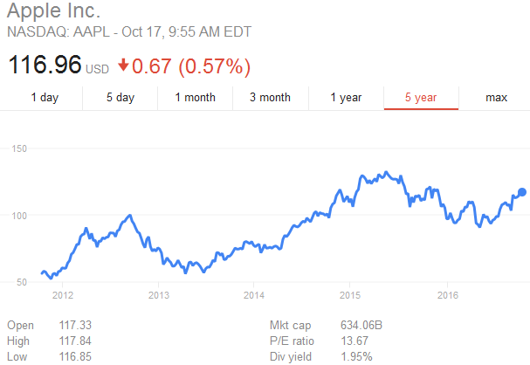
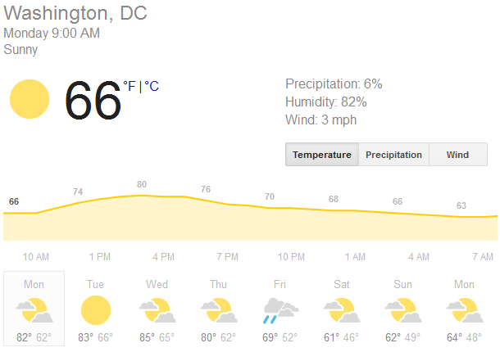
WHAT IS TIME SERIES DATA?
Time series data is any data where the individual data points change over time.
This is fairly common in sales and the physical sciences where data would likely change according to seasons and trends.

Slide 10
WHAT IS TIME SERIES DATA?
Most datasets are likely to have a time component, but typically we assume that it’s fairly minimal.
For example, if we were analyzing salaries in an industry, it’s clear that salaries shift over time and vary with the economic period.
However, if we are examining the problem on a smaller scale (e.g. 3-5 years), the effect of time on salaries is much smaller than other factors, like industry or position.

Slide 11
WHAT IS TIME SERIES DATA?
When the time component is important, we need to focus on identifying the aspects of the data that are influenced by time and those that aren’t.
Typically, time series data will be a sequence of values. We will be interested in studying the changes to this series and how related individual values are.
For example, how much does this week’s sales affect next week’s? How much does today’s stock price affect tomorrow’s?

Slide 12
GUIDED PRACTICE
THINKING ABOUT
TIME SERIES

Slide 13

ACTIVITY: THINKING ABOUT TIME SERIES
ANSWER THE FOLLOWING QUESTIONS (10 minutes):
EXERCISE
What data have you worked with or seen that would be considered time series data?
What was the most frustrating part of working with this time series data?
DELIVERABLE
Answers to the above questions

Slide 14
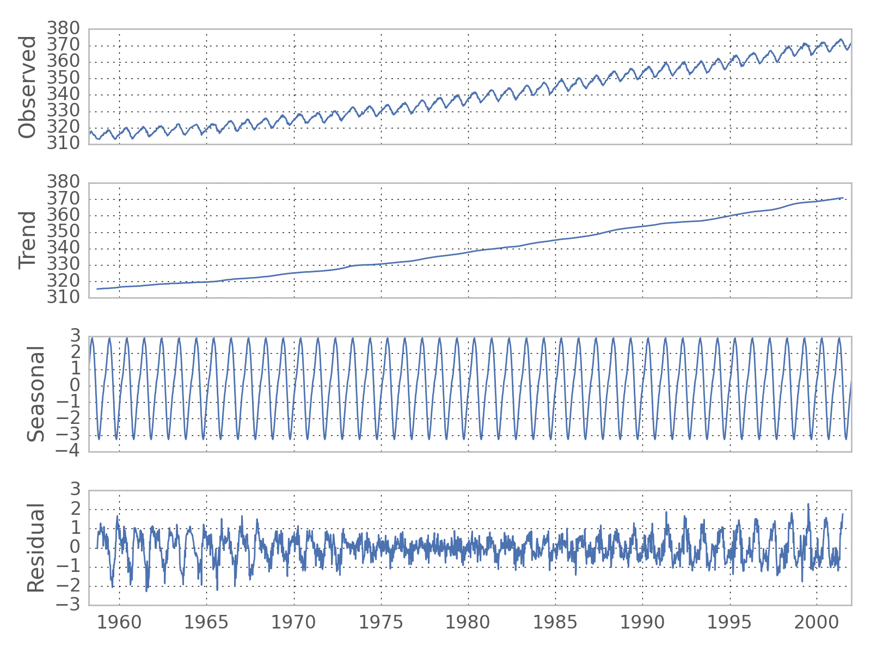
WHAT IS TIME SERIES DATA?
Much of time series analysis focuses on separating the effects of time on our data into two main components.
Trend – significant, sustained increases or decreases in our data
Seasonality – regular, repeated patterns in our data

Slide 15
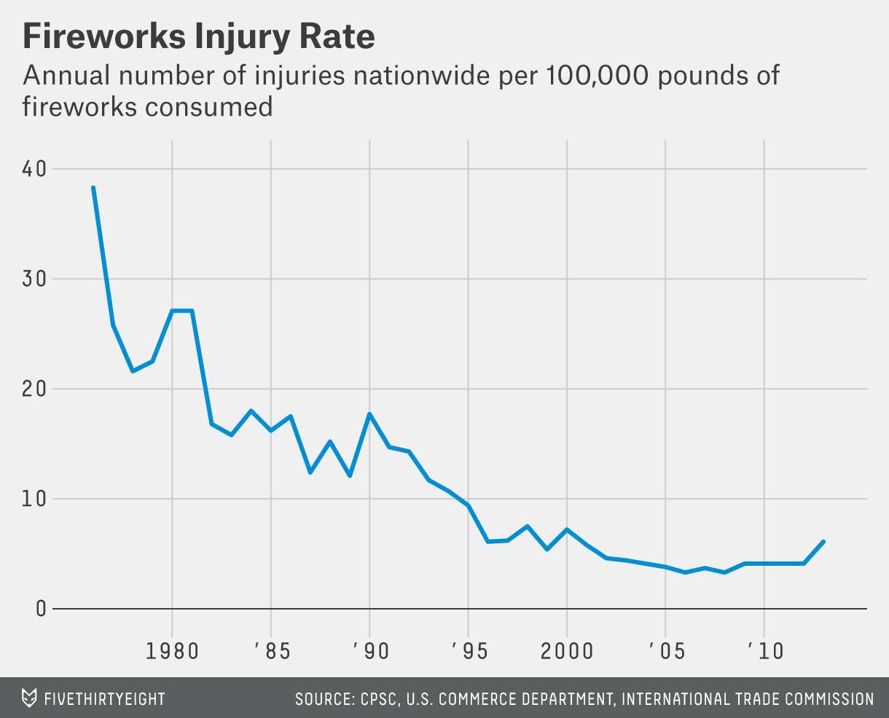
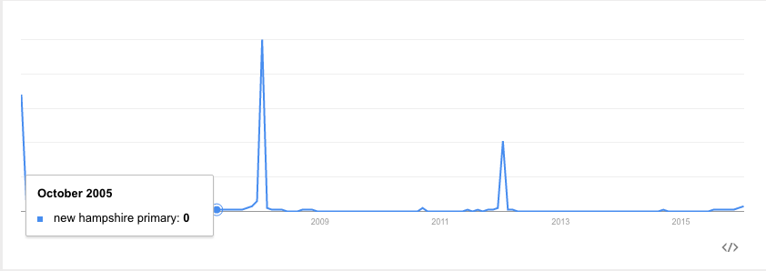
WHAT IS TIME SERIES DATA?
However, not all time series data contain significant trend and seasonality components.

Slide 16
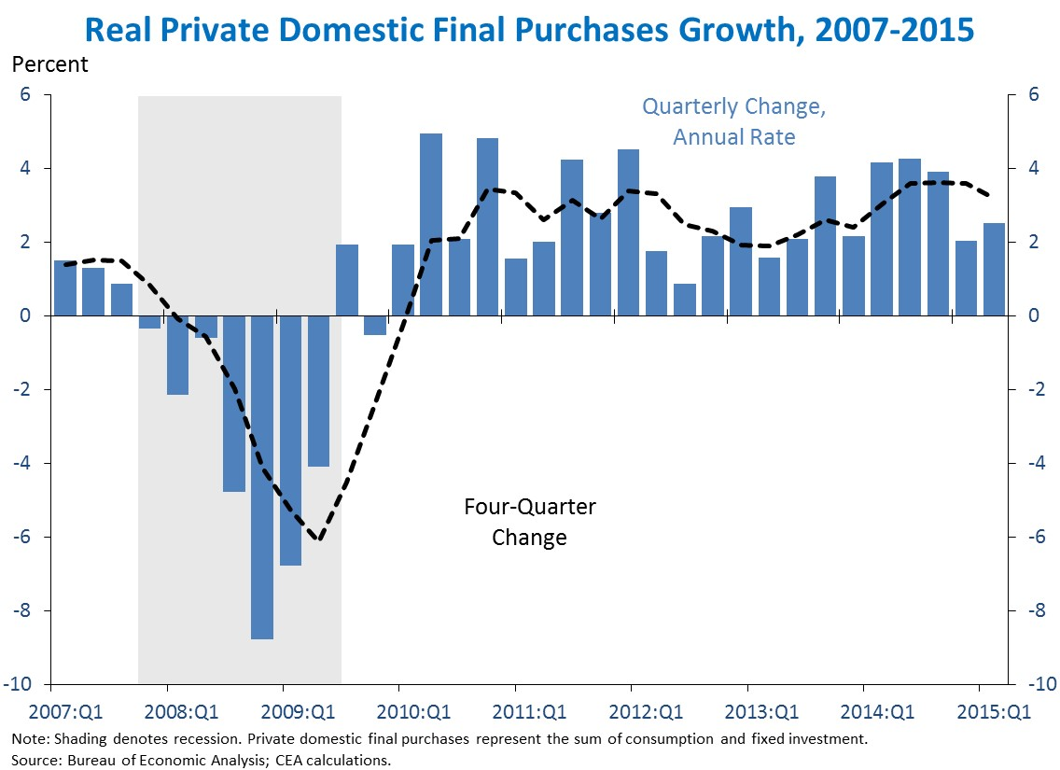
WHAT IS TIME SERIES DATA?
Many other types of regularly occurring up or down swings may occur without a fixed timescale or period (e.g. growth vs. recession for economic trends).

Slide 17
WHAT IS TIME SERIES DATA?
These aperiodic patterns are called cycles.
While identifying aperiodic cycles is important, they are often treated differently than seasonal effects. Seasonal effects are useful for their consistency, since prior data is useful as a predictor.

Slide 18
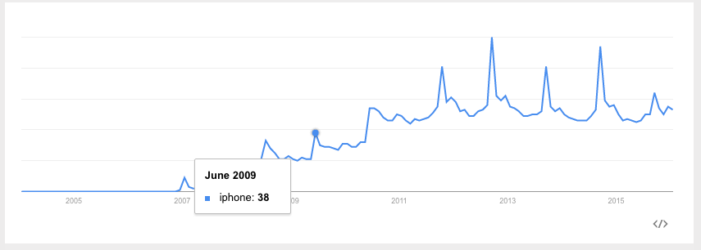
WHAT IS TIME SERIES DATA?
Searches for “iphone” have both a general trend upwards (indicating increasing popularity overall) as well as a seasonal spike in September (when Apple typically announces new versions).

Slide 19
INTRODUCTION
PARSING AND MINING
TIME SERIES DATA

Slide 20
PARSING AND MINING TIME SERIES DATA
As with other analyses, parsing and mining our time series data is going to be key to performing our analysis.
However, this can be tricky working with time series data. Often, the time information is formatted strangely or there are missing values in our regular observations.
As a result, we’re going to want to make sure that our data has been imported properly and the time information is being correctly interpreted by Python.

Slide 21
DEMO
PARSING AND MINING
TIME SERIES DATA

Slide 22
PARSING AND MINING TIME SERIES DATA
Open up starter-code-15 and let’s walkthrough how to use Pandas to parse and mine a sample time series dataset.

Slide 23
INTRODUCTION
REFINING
TIME SERIES DATA

Slide 24
REFINING TIME SERIES DATA
Now that we’ve parsed and mined our data, we can use it for analysis!
The most common approach to analyzing time series data is to calculate a moving/rolling average of our data or the average of a changing subset or window our of data.
The average of this list [1, 2, 3, 4, 5] is 3, but the moving average with a window of 3 would be [NaN, NaN, 2, 3, 4].
Note that NaNs are generated for the entries where there is not enough data to calculate the moving average.

Slide 25
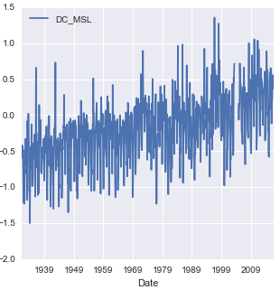
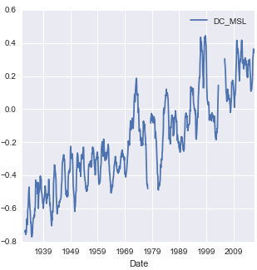
REFINING TIME SERIES DATA
The reason why moving averages are so popular is because they smooth out the noise in our data to give a clearer picture of the overall trend.
Moving Average
(with Window 12)

Slide 26
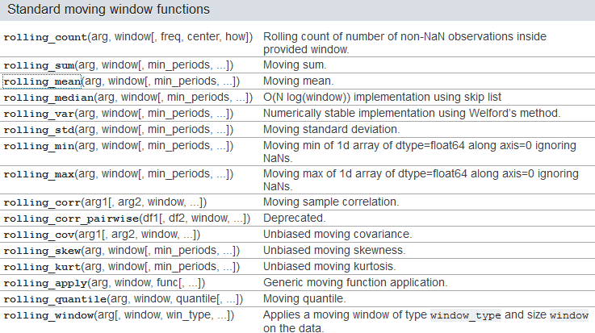
MOVING AVERAGES
Pandas includes a series of moving/rolling functions that you can use to easily calculate different summary statistics over a window of time series data.

Slide 27
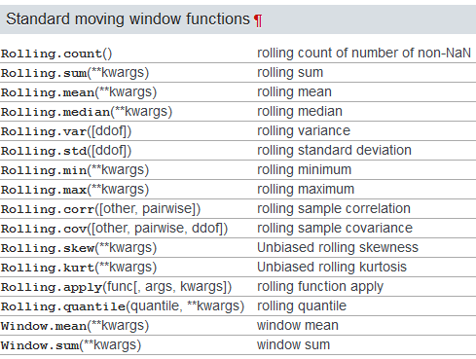
MOVING AVERAGES
If you have Pandas >= 0.18.0 installed, the syntax for these function (and some of the later ones) is similar but slightly different.

Slide 28
MOVING AVERAGES
While moving averages weight all data within our window evenly, it may make sense to weight data closer to our date of interest higher. This would indicate that the present is worth more to our calculation than the past.
We do this by taking a weighted moving average, where we assign particular weights to certain time points.
Various formulas or schemes can be used to weight the data points, the most common weighting is an exponential weighted moving average (EWMA) where we give increasingly less weight to older data points.

Slide 29
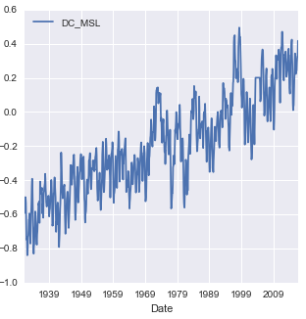
MOVING AVERAGES
Here’s what an EWMA looks like with our DC sea level data.
EWMA
(with Span 12)

Slide 30
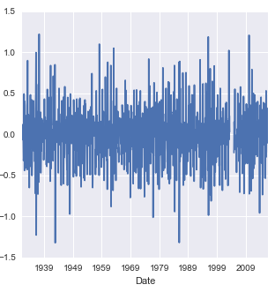
MOVING DIFFERENCES
Often, it can also be useful to calculate the moving/rolling differences to identify the change between past and current observations.
Moving Difference
(with Periods 1)

Slide 31
AUTOCORRELATION
In previous classes, we have been concerned with how two variables are correlated (e.g. height and weight, education and salary) as a measure of association between them.
In time series analysis, it can be important to determine if a variable is correlated with itself (e.g. if there is an association between past and present data points). This measure is known as autocorrelation.
A strong autocorrelation indicates a relationship between past and present data points while a weak autocorrelation represents a lack of association between past and present data points.

Slide 32
AUTOCORRELATION
To compute autocorrelation, we also specify the lag or how many time points earlier we should use to compute the correlation.
A lag of 1 computes how correlated a value is with the prior one. A lag of 10 computes how correlated a value is with one 10 time points earlier.
Here’s a few sample autocorrelations with DC sea level rise data:
Lag | Autocorrelation
1 | 0.699
3 | 0.369
6 | 0.187
12 | 0.635

Slide 33
AGGREGATION
It may also be useful to aggregate our data along specific timeframes such as turning monthly data into annual data as this removes any intra-annual seasonality.
In order to do this, we’ll need to specify a summary statistic to aggregate with though (e.g. average).
We can do this using pandas’ resample function which turns our monthly sea level data into annual average sea level data.

Slide 34
DEMO
REFINING
TIME SERIES DATA

Slide 35
REFINING TIME SERIES DATA
Open up starter-code-15 and let’s take a look at some of these refinement functions in action.

Slide 36
ACTIVITY: REFINING TIME SERIES DATA
ANSWER THE FOLLOWING QUESTIONS (30 minutes):
EXERCISE
Using the Chesapeake Bay sea level data, answer the following questions and interpret the result.
Calculate the moving/rolling standard deviation with rolling_std for a window of 12 with center=True and center = False.
Calculate the autocorrelation with lag 1 and lag 24.
Calculate the annual maximum sea level and plot the results.
DELIVERABLE
Answers to the above questions

Slide 37
CONCLUSION
TOPIC REVIEW

Slide 38
CONCLUSION
We use time series analysis to identify changes in values over time. Normally, we want to identify whether changes are true trends or seasonal changes.
Before any analysis, we must format, index, and interpolate our time series data.
Moving averages give us a local summary statistic in time, smoothing out random fluctuations and removing outliers.
Autocorrelations are a measure of how much a data point is dependent on previous data points.

Slide 39
TIME SERIES MODELING

Slide 40
LEARNING OBJECTIVES
TIME SERIES MODELING
Model and predict from time series data using AR, ARMA, or ARIMA models
Specifically, coding these models in statsmodels

Slide 41
COURSE
PRE-WORK

Slide 42
PRE-WORK REVIEW
Prior definition and Python functions for moving averages and autocorrelation
Prior exposure to linear regression with discussion of coefficients and residuals
pip install statsmodels (should be included with Anaconda)

Slide 43
OPENING
TIME SERIES MODELING

Slide 44
TIME SERIES MODELING
In the last section, we focused on exploring time series data and common statistics for time series analysis.
Now we will advance those techniques to show how to predict or forecast forward from time series data.
With a sequence of values (a time series), we will use the techniques in this class to predict a future value.

Slide 45
TIME SERIES MODELING
There are many times when you may want to use a series of values to predict a future value.
The number of sales in a future month
Anticipated website traffic when buying a server
Financial forecasting
The number of visitors to your store during the holidays

Slide 46
INTRODUCTION
WHAT ARE TIME SERIES MODELS?

Slide 47
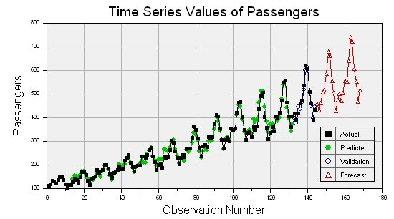
WHAT ARE TIME SERIES MODELS?
Time series models are models that will be used to predict a future value in the time series.
Like other predictive models, we will use prior history to predict the future.
Unlike previous models, we will use the earlier in time outcome variables as inputs for predictions.

Slide 48
WHAT ARE TIME SERIES MODELS?
Like previous modeling exercises, we will have to evaluate the different types of models to ensure we have chosen the best one.
We will want to evaluate on a held-out set or test data to ensure our model performs well on unseen data.

Slide 49
WHAT ARE TIME SERIES MODELS?
Unlike previous modeling exercises, we won’t be able to use standard cross-validation for evaluation.
Since there is a time component to our data, we cannot choose training and test examples at random.
Suppose we did select a random 80% sample of data points for training and a random 20% for testing. What could go wrong?

Slide 50
WHAT ARE TIME SERIES MODELS?
The training dataset would likely contain data from before AND after a test dataset.
This would not be possible in real life (you can’t use future, unseen data points when building your model). Therefore, it’s not a valid test of how our model would perform in practice.

Slide 51
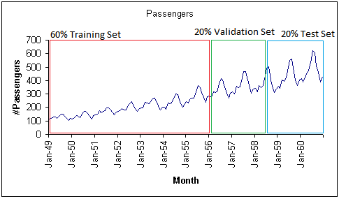
WHAT ARE TIME SERIES MODELS?
Instead, we will exclusively train on values earlier (in time) in our data and test our model on values at the end of the data period.

Slide 52
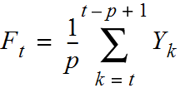
PROPERTIES FOR TIME-SERIES PREDICTION
A moving average is an average of p surrounding data points in time.
… to t - p + 1. This includes t, t + 1, t + 2, …, t-p, t-p+1.
Divide by the p surrounding data points
Get the p points from t ...

Slide 53
ACTIVITY: KNOWLEDGE CHECK
ANSWER THE FOLLOWING QUESTIONS
EXERCISE
We previously looked at auto-correlation to compute the relationship of the data with prior values.
Recall the definition of autocorrelation and its purpose.
DELIVERABLE
Answers to the above questions

Slide 54
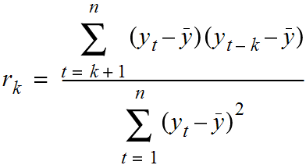
PROPERTIES FOR TIME-SERIES PREDICTION
Autocorrelation is how correlated a variable is with itself. Specifically, how related are variables earlier in time with variables later in time.
We fix a lag, k, which is how many time points earlier we should use to compute the correlation.

Slide 55
PROPERTIES FOR TIME-SERIES PREDICTION
We can use these values to assess how we plan to model our time series.
Typically, for a high quality model, we require some autocorrelation in our data.
We can compute autocorrelation at various lag values to determine how far back in time we need to go.

Slide 56
PROPERTIES FOR TIME-SERIES PREDICTION
Many models make an assumption of stationarity, assuming the mean and variance of our values is the same throughout.
While the values (e.g. of sales) may shift up or down over time, the mean and variance of sales is constant (i.e. there aren’t many dramatic swings up or down).
These assumptions may not represent real world data; we must be aware of that when we are breaking the assumptions of our model.

Slide 57
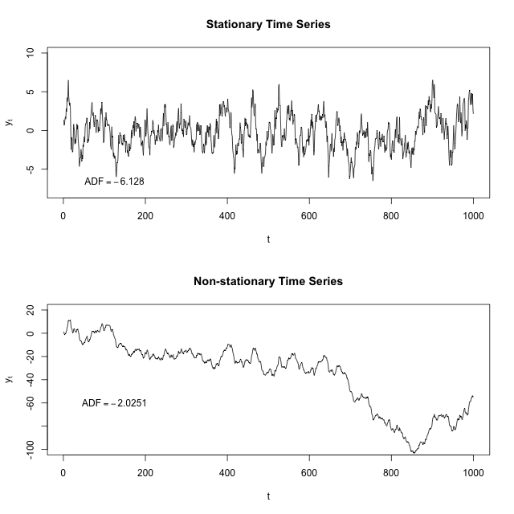
PROPERTIES FOR TIME-SERIES PREDICTION

Slide 58
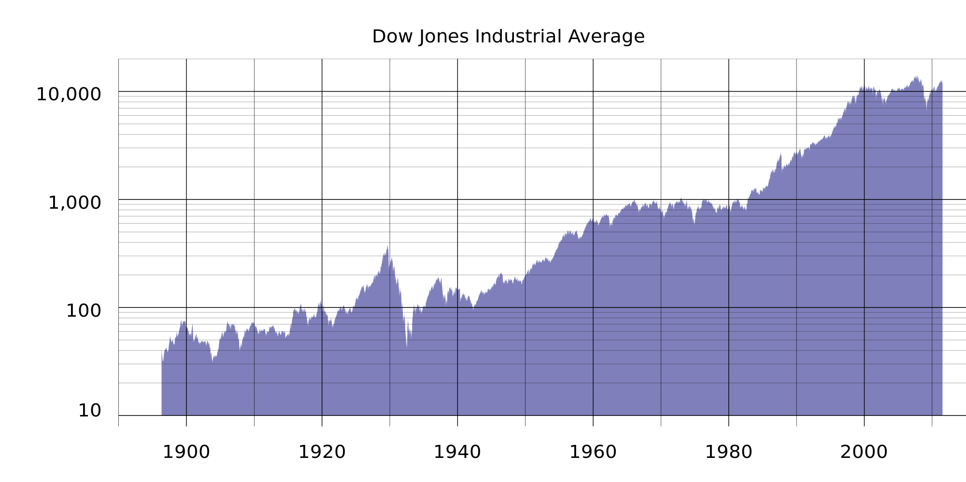
PROPERTIES FOR TIME-SERIES PREDICTION
For example, typical stock or market performance is not stationary. In this plot of Dow Jones performance since 1986, the mean is clearly increasing over time.

Slide 59
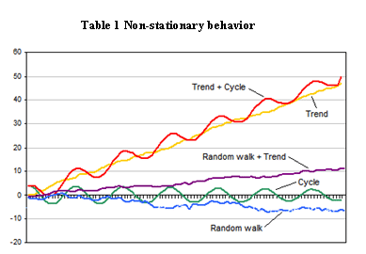
PROPERTIES FOR TIME-SERIES PREDICTION
Below are simulated examples of non-stationary time series and why they might occur.

Slide 60
PROPERTIES FOR TIME-SERIES PREDICTION
Often, if these assumptions don’t hold, we can alter our data to make them true. Two common methods are detrending and differencing.
Detrending would mean to remove any major trends in our data.
We could do this is many ways, but the simplest is to fit a line to the trend and make a new series that is the difference between the line and the true series.

Slide 61
PROPERTIES FOR TIME-SERIES PREDICTION
For example, there is a clear upward (non-stationary) trend in google searches for “iphone”.
If we fit a line to this data first, we can create a new series that is the difference between the true number of searches and the predicted searches.

Slide 62
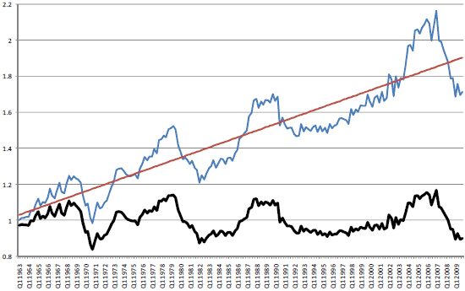
PROPERTIES FOR TIME-SERIES PREDICTION
Below is an example where we look at US housing prices over time. Clearly, there is an upward trend, making the time series non-stationary (ie: the mean house price is increasing).

Slide 63
PROPERTIES FOR TIME-SERIES PREDICTION
We can fit a line that represents the trend. With our trend line, we can subtract the trend line value from the original value to get the bottom figure.

Slide 64
PROPERTIES FOR TIME-SERIES PREDICTION
The data now has a fixed mean and will be easier to model. This pattern is similar to mean-scaling our features in earlier models with StandardScaler.

Slide 65
PROPERTIES FOR TIME-SERIES PREDICTION
A simpler method is differencing. This is very closely related to the diff function we saw earlier.
Instead of predicting the series (again our non-stationary series), we can predict the difference between two consecutive values.

Slide 66
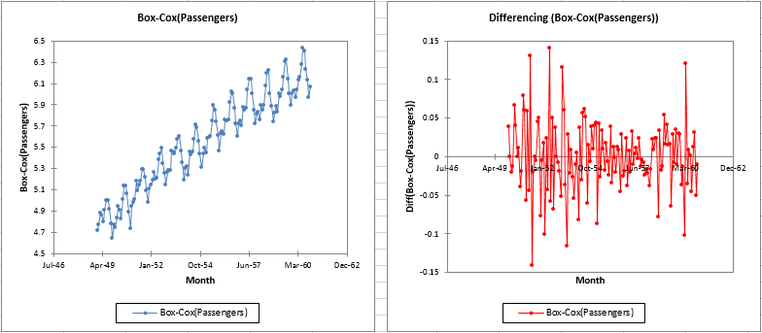
PROPERTIES FOR TIME-SERIES PREDICTION

Slide 67
ACTIVITY: KNOWLEDGE CHECK
ANSWER THE FOLLOWING QUESTIONS
EXERCISE
Non-stationary data is the most common; almost any interesting dataset is non-stationary.
Can you think of some interesting datasets that might be stationary?
DELIVERABLE
Answers to the above questions

Slide 68
TIME SERIES MODELS
In the rest of this lesson, we are going to build up to the ARIMA time series model.
This model combines the ideas of differencing and two models we will see.
AR - autoregressive models
MA - moving average models

Slide 69
AR MODELS
Autoregressive (AR) models are those that use data from previous time points to predict the next.
This is very similar to previous regression models, except as input, we take the previous outcome.
If we are attempting to predict weekly sales, we use the sales from a previous week as input.
Typically, AR models are notes AR(p) where p indicates the number of previous time points to incorporate, with AR(1) being the most common.

Slide 70
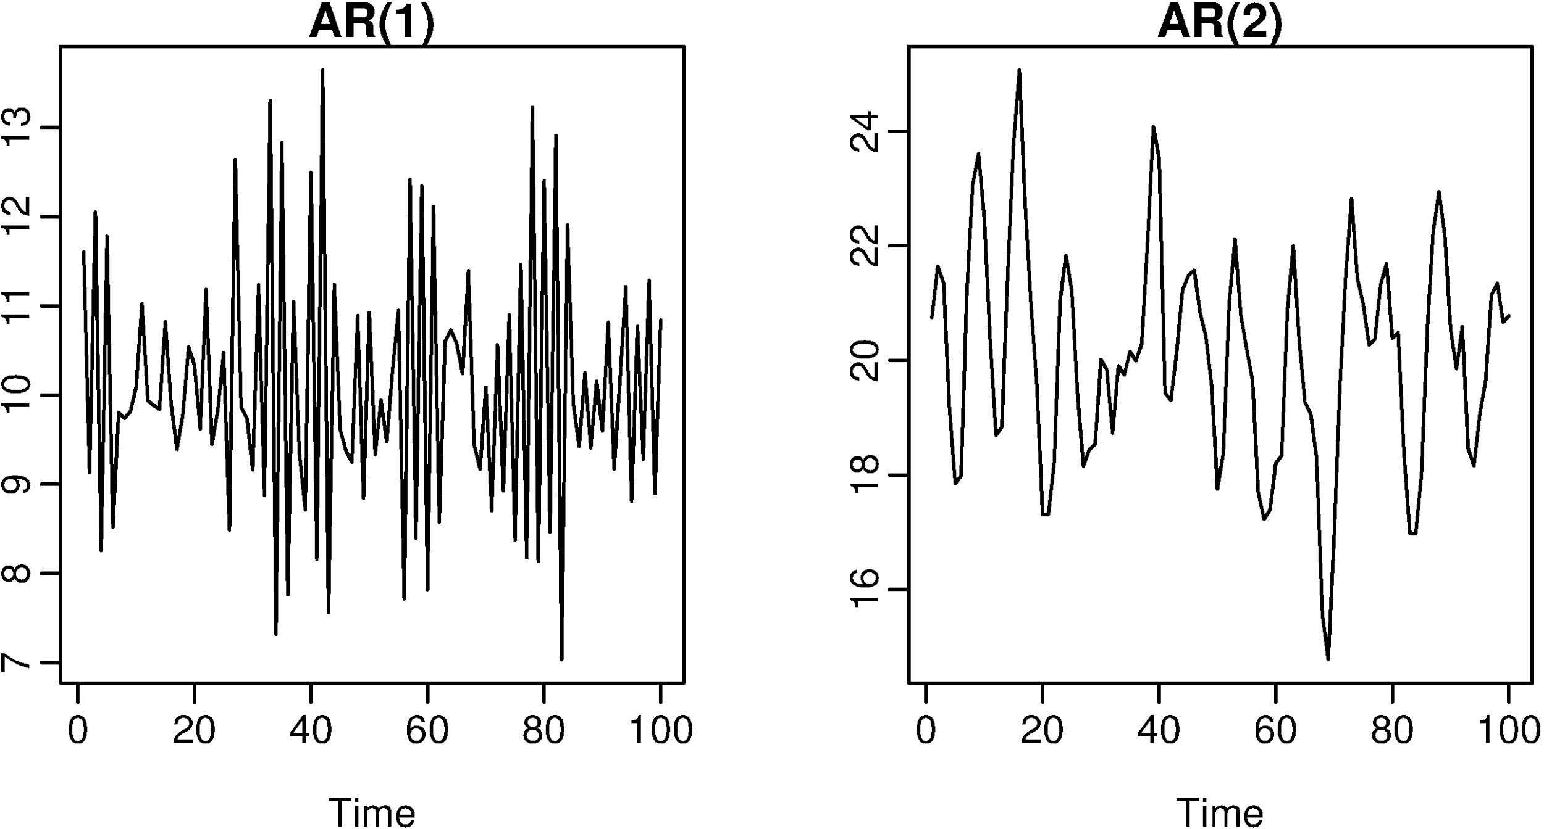
AR MODELS

Slide 71
AR MODELS
In an autoregressive model, similar to standard regression, we are learning regression coefficients for each of the p previous values. Therefore, we will learn p coefficients or 𝛃 values.
If we have a time series of sales per week, y_{i}, we can regress each yi from the last p values.
y_{i} = 𝛃₀ + 𝛃₁y_{i-1} + 𝛃₂y_{i-2} + … + 𝛃_{p}y_{i-p} + 𝜺
As with standard regression, our model assumes that each outcome variable is a linear combination of the inputs and a random error term.

Slide 72
AR MODELS
For an AR(1) model, we will learn a single coefficient.
This coefficient, 𝛃, will tell us the relationship between the previous value, Y_{t - 1}, and the next value, Y_{t}.
Y_{t} = 𝛃·Y_{t - 1}

Slide 73
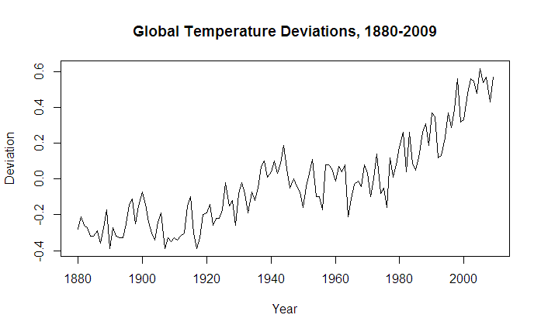
AR MODELS
A value > 1 would indicate a growth over previous values. This would typically represent non-stationary data, since if we compound the increases, the values are continually increasing.

Slide 74
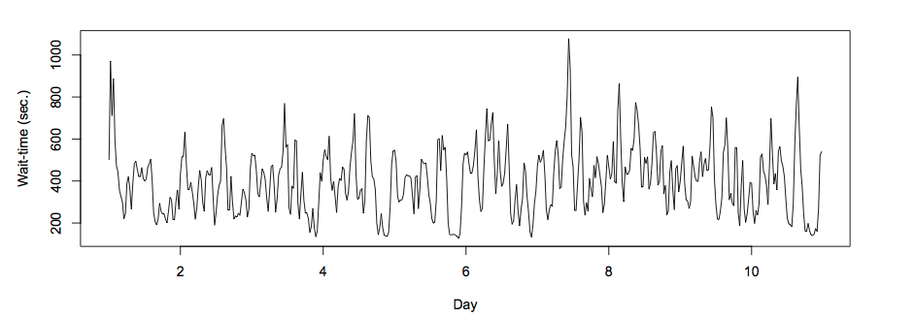
AR MODELS
Values between 1 and -1 represent increasing and decreasing patterns from previous patterns.

Slide 75
AR MODELS
As with other models, interpretation of the model becomes more complex as we add more factors.
Going from AR(1) to AR(2) can add significant multi-collinearity.

Slide 76
AR MODELS
Recall that autocorrelation is the correlation of a value with its series lagged behind.
A model with high correlation implies that the data is highly dependent on previous values and an autoregressive model would perform well.

Slide 77
AR MODELS
Autoregressive models are useful for learning falls or rises in our series.
This will weight together the last few values to make a future prediction.
Typically, this model type is useful for small-scale trends such as an increase in demand or change in tastes that will gradually increase or decrease the series.

Slide 78
ACTIVITY: KNOWLEDGE CHECK
ANSWER THE FOLLOWING QUESTIONS
If we observe an autocorrelation near 1 for lag 1, what do we expect the single coefficient in an AR(1) model to be? >1, between 0 and 1, or <1?
What if we observe an autocorrelation of 0?
EXERCISE
DELIVERABLE
Answers to the above questions

Slide 79
MA MODELS
Moving average (MA) models, as opposed to AR models, do not take the previous outputs (or values) as inputs. They take the previous error terms.
We will attempt to predict the next value based on the overall average and how off our previous predictions were.

Slide 80
MA MODELS
This model is useful for handling specific or abrupt changes in a system.
AR models slowly incorporate changes in the system by combining previous values; MA models use prior errors to quickly incorporate changes.
This is useful for modeling a sudden occurrence - something going out of stock or a sudden rise in popularity affecting sales.

Slide 81
MA MODELS
As in AR models, we have an order term, q, and we refer to our model as MA(q). The moving average model is dependent on the last q errors.
If we have a time series of sales per week, y_{i}, we can regress each y_{i} from the last q error terms.
y_{i} = mean + 𝛃₁𝜺_{i-1} + 𝛃₂𝜺_{i-2} + … + 𝛃_{q}𝜺_{i-q}
We include the mean of the time series (that’s why it’s called a moving average) as we assume the model takes the mean value of the series and randomly jumps around it.

Slide 82
MA MODELS
Of course, we don’t have error terms when we start - where do they come from?
This requires a more complex fitting procedure than we have seen previously.
We need to iteratively fit a model (perhaps with random error terms), compute the errors and then refit, again and again.

Slide 83
MA MODELS
In this model, we learn q coefficients.
In an MA(1) model, we learn one coefficient.
This value indicates the impact of how our previous error term on the next prediction.

Slide 84
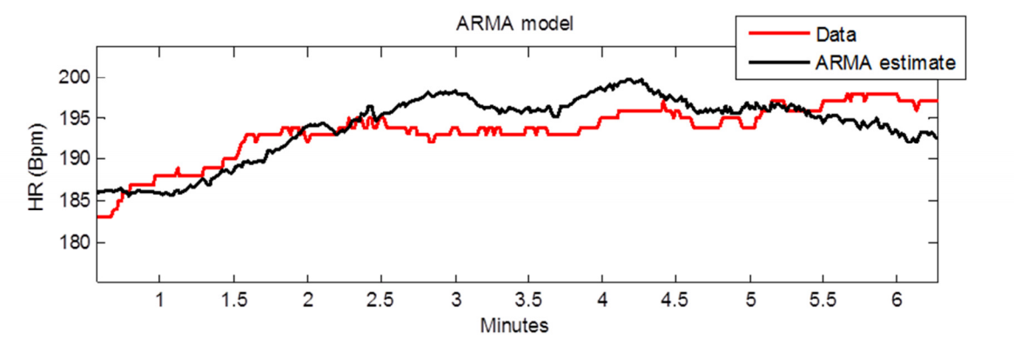
ARMA MODELS
ARMA (pronounced ‘R-mah’) models combine the autoregressive and moving average models.
An ARMA(p,q) model is simply a combination (sum) of an AR(p) model and MA(q) model.

Slide 85
ARMA MODELS
We specify two model settings, p and q, which correspond to combining an AR(p) model with an MA(q) model.
Incorporating both models allows us to mix two types of effects.
AR models slowly incorporate changes in preferences, tastes, and patterns.
Moving average models base their prediction on the prior error, allowing to correct sudden changes based on random events - supply, popularity spikes, etc.

Slide 86
ARIMA MODELS
ARIMA (pronounced ‘uh-ri-mah’) is an AutoRegressive Integrated Moving Average model.
In this model, we learn an ARMA(p,q) model to predict the difference of the series (as opposed to the value of the series).

Slide 87
ARIMA MODELS
Recall the pandas diff function. This computes the difference between two consecutive values.
In an ARIMA model, we attempt to predict this difference instead of the actual values.
y_{t} - y_{t-1} = ARIMA(p,q)
This handles the stationarity assumption we wanted for our data. Instead of detrending or differencing manually, the model does this.

Slide 88
ARIMA MODELS
An ARIMA model has three parameters and is specified ARIMA(p, d, q).
p is the order of the autoregressive component
q is the order of the moving average component
d is the degree of differencing.
d was 1 in our prior example. For d=2, our model would be
diff(diff(y)) = (y_{t} - y_{t-l}) - (y_{t-l} - y_{t-2}) = ARIMA(p,q)

Slide 89
ARIMA MODELS
Compared to an ARMA model, ARIMA models do not rely on the underlying series being stationary.
The differencing operation can convert the series to one that is stationary.
Instead of attempting to predict values over time, our new series is the difference in values over time.
Since ARIMA models include differencing, they can be used on a broader set of data without the assumption of a constant mean.

Slide 90
DEMO
TIME SERIES MODELING IN STATSMODELS

Slide 91
TIME SERIES MODELING IN STATSMODELS
To explore time series models, we will continue to use the Rossmann sales data.
This dataset has sales data for every Rossmann store for a 3-year period and indicators for holidays and basic store information.

Slide 92
TIME SERIES MODELING IN STATSMODELS
In the last class, we saw that we could plot the sales data at a particular store to identify how the sales changed over time.
We also computed autocorrelation for the data at varying lag periods. This helps us identify if previous timepoints are predictive of future data and which time points are most important - the previous day, week, or month.

Slide 93
TIME SERIES MODELING IN STATSMODELS
import pandas as pd # Load the data and set the DateTime index data = pd.read_csv('../assets/dataset/rossmann.csv', skipinitialspace=True) data['Date'] = pd.to_datetime(data['Date']) data.set_index('Date', inplace=True) # Filter to Store 1 store1_data = data[data.Store == 1] # Filter to open days store1_open_data = store1_data[store1_data.Open==1] # Plot the sales over time store1_open_data[['Sales']].plot()

Slide 94
ACTIVITY: KNOWLEDGE CHECK
ANSWER THE FOLLOWING QUESTIONS
Compute the autocorrelation of Sales in Store 1 for lag 1 and 2.
Will we be able to use a predictive model, particularly an autoregressive one?
EXERCISE
DELIVERABLE
Answers to the above questions

Slide 95
TIME SERIES MODELING IN STATSMODELS
store1_data.Sales.autocorr(lag=1) # -0.12 store1_data.Sales.autocorr(lag=2) # -0.03
We do see some minimal correlation in time, implying an AR model can be useful. An easier way to diagnose this may be to plot many autocorrelations at once.

Slide 96
TIME SERIES MODELING IN STATSMODELS
%matplotlib inline from pandas.tools.plotting import autocorrelation_plot autocorrelation_plot(store1_data.Sales)
This shows a typical pattern of an autocorrelation plot, that it should decrease to 0 as lag increases. However, it’s hard to observe exactly what the values are.

Slide 97
TIME SERIES MODELING IN STATSMODELS
In this class, we will use statsmodels to code AR, MA, ARMA, and ARIMA models.
statsmodels provides a nice summary utility to help us diagnose models.

Slide 98
TIME SERIES MODELING IN STATSMODELS
statsmodels also has a better autocorrelation plot that allows us to look at fixed number of lag values.
from statsmodels.graphics.tsaplots import plot_acf plot_acf(store1_data.Sales, lags=10)
Here we observe autocorrelation at 10 lag values. 1 and 2 are what we saw before.
This implies a small but limited impact based on the last few values. An autoregressive model might be useful.

Slide 99
TIME SERIES MODELING IN STATSMODELS
We also see a larger spike at 7 (the seventh day in the week).
If we observed a handful of random distributed spikes, a moving average model would be useful.
plot_acf(store1_data.Sales, lags=25)
We can expand the window to 25 days to see that the random spikes occur regularly at 7 days. What does this mean?

Slide 100
AR, MA, AND ARMA MODELS IN STATSMODELS
To explore AR, MA, and ARMA models, we will use sm.tsa.ARMA.
Remember, an ARMA model is a combination of autoregressive and moving average models.
We can train an AR model by turning off the MA component (q=0).
from statsmodels.tsa.arima_model import ARMA store1_sales_data = store1_open_data[['Sales']].astype(float) model = ARMA(store1_sales_data, (1, 0)).fit() model.summary()

Slide 101
AR, MA, AND ARMA MODELS IN STATSMODELS
By passing (1, 0) in the second argument, we are fitting an ARMA model with p=1, q=0. This is the same as an AR(1) model.
In this AR(1) model, we learn an intercept (or base sales) value.
Additionally, we learn a coefficient that tells us how to include the latest sales value.
In this case, we add an intercept of ~4700 to 0.68 times the previous month’s sales. Note that the coefficient is not equal to the lag 1 autocorrelation. This implies the data is not stationary.

Slide 102
AR, MA, AND ARMA MODELS IN STATSMODELS
We can learn an AR(2) model, which regresses each sales value on the last two.
model = ARMA(store1_sales_data, (2, 0)).fit() model.summary()
In this case, we learn two coefficients, which tell us the effect of the last two sales values on the current sales.
While this model may perform better, it may be more difficult to interpret.

Slide 103
ACTIVITY: KNOWLEDGE CHECK
ANSWER THE FOLLOWING QUESTIONS
EXERCISE
To start to diagnose the model, we want to look at residuals.
What are residuals?
In linear regression, what did we expect of residuals?
DELIVERABLE
Answers to the above questions

Slide 104
AR, MA, AND ARMA MODELS IN STATSMODELS
Residuals are the errors of the model or how off our predictions are.
Ideally, we want randomly distributed errors that are small.
If the errors are large, our model does not perform well.
If the errors have a pattern, particularly over time, we may have overlooked something in the model or have periods of time that are different than the rest of the dataset.

Slide 105
AR, MA, AND ARMA MODELS IN STATSMODELS
We can use statsmodels to plot the residuals.
model.resid.plot()
Here we see large spikes at the end of each year, indicating that our model does not account for the holiday spikes.
Our model considers a short period of time, so it does not take into account the longer seasonal pattern.

Slide 106
AR, MA, AND ARMA MODELS IN STATSMODELS
We can also plot the autocorrelations of the residuals. In an ideal world, these would all be near 0 and appear random.
plot_acf(model.resid, lags=50)
This plot shows a problem: the errors are increasing and decreasing every week in a clear pattern.
We may need to expand our model.

Slide 107
AR, MA, AND ARMA MODELS IN STATSMODELS
To expand this AR model to an ARMA model, we can include the moving average component as well.
model = ARMA(store1_sales_data, (1, 1)).fit() model.summary()
Now we learn two coefficients, one for the AR(1) component and one for the MA(1) component.

Slide 108
ACTIVITY: KNOWLEDGE CHECK
ANSWER THE FOLLOWING QUESTIONS
Take a moment to look at the coefficients of our new model.
Offer an interpretation of this model.
EXERCISE
DELIVERABLE
Answers to the above questions

Slide 109
AR, MA, AND ARMA MODELS IN STATSMODELS
Remember that this is an AR(1) + MA(1) model. The AR coefficient represents dependency on the last value and the MA component represents any spikes independent of the last value.
The coefficients here are 0.69 for the AR component and -0.03 for the MA component.
The AR coefficient is the same as before (decreasing values).
The MA component is fairly small (which we should have expected from the autocorrelation plots).

Slide 110
ARIMA MODELS IN STATSMODELS
We can also use statsmodels to fit ARIMA models. Let’s start by using ARIMA(1, 0, 1) to fit an ARMA(1, 1) model.
from statsmodels.tsa.arima_model import ARIMA model = ARIMA(store1_sales_data, (1, 0, 1)).fit() model.summary()
We can see that this model is the same as our previous ARMA model.

Slide 111
ARIMA MODELS IN STATSMODELS
We can also fit a true ARIMA model to predict the difference of the series.
model = ARIMA(store1_sales_data, (1, 1, 1)).fit() model.summary()
We can remove the MA component since it does not appear to be useful.
model = ARIMA(store1_sales_data, (1, 1, 0)).fit() model.summary()
We now have an AR(1) model on the differenced series with a coefficient of -0.18.

Slide 112
ACTIVITY: KNOWLEDGE CHECK
ANSWER THE FOLLOWING QUESTIONS
Does this model match the lag 1 autocorrelation of the differenced series?
Is the data stationary?
EXERCISE
DELIVERABLE
Answers to the above questions

Slide 113
ARIMA MODELS IN STATSMODELS
We can compute the lag 1 autocorrelation of the differenced series and see if they match.
store1_sales_data.Sales.diff(1).autocorr(1) #-0.181
We can also plot it to see the difference.
store1_sales_data.Sales.diff(1).plot()
They match. Note that this is generally true, but the variance is NOT constant. It’s mostly the same throughout the series except around the holidays.

Slide 114
ARIMA MODELS IN STATSMODELS
With our models, we can also plot our predictions against the true series using the plot_predict function.
We can compare the last 50 days of true values against our predictions.
model.plot_predict(0, 50)
The function takes two arguments, the start and end index of the dataframe to plot. Here, we are plotting the last 50 values.

Slide 115
ARIMA MODELS IN STATSMODELS
To plot earlier values with our predictions continuing where the true values stop, we can do the following.
import matplotlib.pyplot as plt fig, ax = plt.subplots() ax = store1_sales_data['2014'].plot(ax=ax) fig = model.plot_predict(0, 200, ax=ax, plot_insample=False)
This plots true values in 2014 and our predictions 200 days out from 2014.

Slide 116
ACTIVITY: KNOWLEDGE CHECK
ANSWER THE FOLLOWING QUESTIONS
We can revisit our diagnostics to check that our models are working well.
Plot the residuals and autocorrelation of the residuals.
Are there patterns or outliers?
EXERCISE
DELIVERABLE
Answers to the above questions

Slide 117
ARIMA MODELS IN STATSMODELS
The two previous problems remain:
Large errors around the holiday period
Errors with high autocorrelation

Slide 118
ARIMA MODELS IN STATSMODELS
We can adjust the AR component of the model to adjust for a piece of this. Let’s increase the lag to 7.
model = ARIMA(store1_sales_data, (7, 1, 2)).fit() model.summary() plot_acf(model.resid, lags=50)
This removes some of the autocorrelation in the residuals but large discrepancies still exist.
However, they exist where we are breaking our model assumptions.

Slide 119
ACTIVITY: KNOWLEDGE CHECK
ANSWER THE FOLLOWING QUESTIONS
Alter the time period of predictions and the p, d, and q parameters.
Do any of these improve diagnostics?
What does changing p and q imply based upon the autocorrelation plot?
How about changing d?
EXERCISE
DELIVERABLE
Answers to the above questions

Slide 120
ARIMA MODELS IN STATSMODELS
Increasing p increases the dependency on previous values further (longer lag). But our autocorrelation plots show this isn’t necessary past a certain point.
Increasing q increases the likelihood of an unexpected jump at a handful of points. The autocorrelation plots show this doesn’t help past a certain point.
Increasing d increases differencing, but d=1 moves our data towards stationarity (other than a few points). d=2 would imply an exponential trend which we don’t have here.

Slide 121
ARIMA MODELS IN STATSMODELS
There are variants of ARIMA that will better handle the seasonal aspect of our data. This is referred to as Seasonal ARIMA.
These models fit two ARIMA models, one on the current frequency (daily in our example) and another on the seasonal frequency (maybe monthly or yearly patterns).
Additionally, issues with seasonality could be handled by preprocessing tricks such as detrending.

Slide 122
INDEPENDENT PRACTICE
WALMART SALES DATA

Slide 123
ACTIVITY: WALMART SALES DATA
DIRECTIONS (50 minutes)
EXERCISE
We will analyze the weekly sales data from Walmart over a two year period from 2010 to 2012. The data is separated by store and department, but we will focus on analyzing one store for simplicity.
To read in the data
import pandas as pd import numpy as np %matplotlib inline data = pd.read_csv('lessons/lesson-16/assets/data/train.csv') data.set_index('Date', inplace=True) data.head()

Slide 124
ACTIVITY: WALMART SALES DATA
DIRECTIONS
EXERCISE
Complete the following tasks:
Filter the dataframe to Store 1 sales and aggregate over departments to compute the total sales per store.
Plot the rolling_mean for Weekly_Sales. What general trends do you observe?
Compute the 1, 2, 52 autocorrelations for Weekly_Sales and/or create an autocorrelation plot.
What does the autocorrelation plot say about the type of model you want to build?

Slide 125
ACTIVITY: WALMART SALES DATA
DIRECTIONS
EXERCISE
Split the weekly sales data in a training and test set - using 75% of the data for training.
Create an AR(1) model on the training data and compute the mean absolute error of the predictions.
Plot the residuals - where are their significant errors?
Compute and AR(2) model and an ARMA(2, 2) model - does this improve your mean absolute error on the held out set?
Finally, compute an ARIMA model to improve your prediction error - iterate on the p, q, and parameters comparing the model's performance..

Slide 126
CONCLUSION
TOPIC REVIEW

Slide 127
CONCLUSION
Time-series models use previous values to predict future values, also known as forecasting.
AR and MA model are simple models on previous values or previous errors respectively.
ARMA combines these two types of models to account for both gradual shifts (due to AR models) and abrupt changes (MA models).

Slide 128
CONCLUSION
ARIMA models train ARMA models on differenced data to account for non-stationary data.
Note that none of these models may perform well for data that has more random variation.
For example, for something like iphone sales (or searches) which may be sporadic, with short periods of increases, these models may not work well.

Slide 129
LESSON
Q & A

Slide 130
LESSON
EXIT TICKET
DON’T FORGET TO FILL OUT YOUR EXIT TICKET
LESSON 15
TIME SERIES ANALYSIS

Slide 131
CITATIONS
THANKS FOR THE FOLLOWING
Rolling Functions: http://pandas.pydata.org/pandas-docs/version/0.17.0/api.html#standard-moving-window-functions
Newer Rolling Functions: http://pandas.pydata.org/pandas-docs/version/0.18.1/api.html#standard-moving-window-functions

